Slide 1
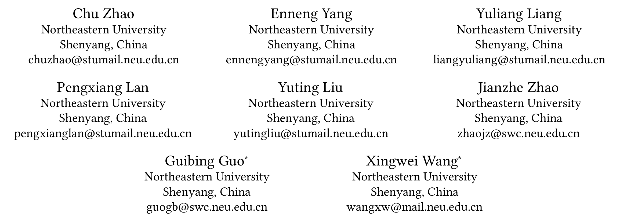
ATAI
Advanced Technique of Artificial Intelligence
ATAI
ChongqingUniversity _{AdvancedTechniqueof}
of Technology Artificial Intelligence
Chongqing University of
Technology
Chongqing University ^{ATAI}
_{of Technology} Advanced Techniqueof
Artificial Intelligence
Chongqing University of Technology
Chongqing University of Technology
Graph Representation Learning via Causal Diffusion for
Out-of-Distribution Recommendation
Code : https://github.com/user683/CausalDiffRec.
—— WWW’2025
Reported by Yang Jiang
1

Slide 2
ATAI
Advanced Technique of Artificial Intelligence
ATAI
ChongqingUniversity _{AdvancedTechniqueof}
of Technology Artificial Intelligence
Chongqing University of
Technology
Chongqing University ^{ATAI}
_{of Technology} Advanced Techniqueof
Artificial Intelligence
Chongqing University of Technology
Chongqing University of Technology
Introduction
most existing methods assume that test and training datasets follow an independently and identically distributed (IID) pattern, focusing on performance improvements under this assumption. Such methods struggle to generalize effectively to out-of-distribution(OOD) data.

Slide 3
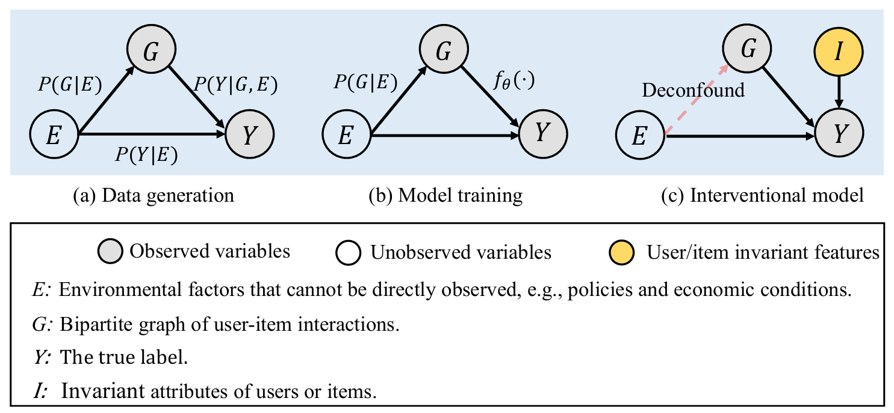
ATAI
Advanced Technique of Artificial Intelligence
ATAI
ChongqingUniversity _{AdvancedTechniqueof}
of Technology Artificial Intelligence
Chongqing University of
Technology
Chongqing University ^{ATAI}
_{of Technology} Advanced Techniqueof
Artificial Intelligence
Chongqing University of Technology
Chongqing University of Technology
Introduction

Slide 4
ATAI
Advanced Technique of Artificial Intelligence
ATAI
ChongqingUniversity _{AdvancedTechniqueof}
of Technology Artificial Intelligence
Chongqing University of
Technology
Chongqing University ^{ATAI}
_{of Technology} Advanced Techniqueof
Artificial Intelligence
Chongqing University of Technology
Chongqing University of Technology
Overview

Slide 5
ATAI
Advanced Technique of Artificial Intelligence
ATAI
ChongqingUniversity _{AdvancedTechniqueof}
of Technology Artificial Intelligence
Chongqing University of
Technology
Chongqing University ^{ATAI}
_{of Technology} Advanced Techniqueof
Artificial Intelligence
Chongqing University of Technology
Chongqing University of Technology
Priliminary

Slide 6
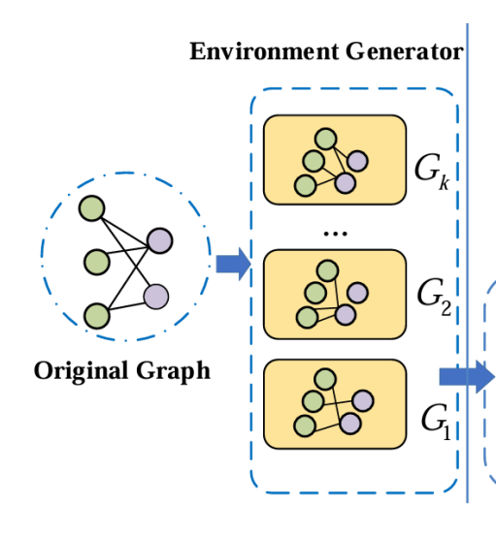
ATAI
Advanced Technique of Artificial Intelligence
ATAI
ChongqingUniversity _{AdvancedTechniqueof}
of Technology Artificial Intelligence
Chongqing University of
Technology
Chongqing University ^{ATAI}
_{of Technology} Advanced Techniqueof
Artificial Intelligence
Chongqing University of Technology
Chongqing University of Technology
Method
Environment Generator.

Slide 7
ATAI
Advanced Technique of Artificial Intelligence
ATAI
ChongqingUniversity _{AdvancedTechniqueof}
of Technology Artificial Intelligence
Chongqing University of
Technology
Chongqing University ^{ATAI}
_{of Technology} Advanced Techniqueof
Artificial Intelligence
Chongqing University of Technology
Chongqing University of Technology
Method

Slide 8
ATAI
Advanced Technique of Artificial Intelligence
ATAI
ChongqingUniversity _{AdvancedTechniqueof}
of Technology Artificial Intelligence
Chongqing University of
Technology
Chongqing University ^{ATAI}
_{of Technology} Advanced Techniqueof
Artificial Intelligence
Chongqing University of Technology
Chongqing University of Technology
Method
CausalDiffusion

Slide 9
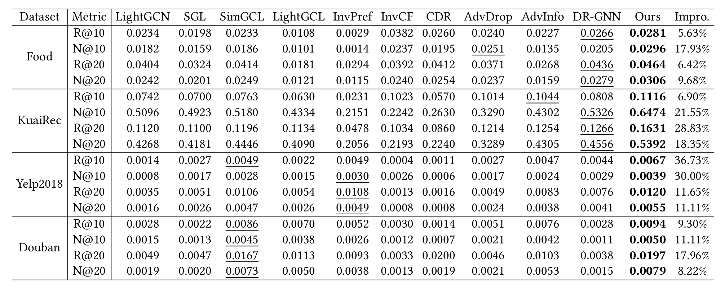
ATAI
Advanced Technique of Artificial Intelligence
ATAI
ChongqingUniversity _{AdvancedTechniqueof}
of Technology Artificial Intelligence
Chongqing University of
Technology
Chongqing University ^{ATAI}
_{of Technology} Advanced Techniqueof
Artificial Intelligence
Chongqing University of Technology
Chongqing University of Technology
Experiments

Slide 10
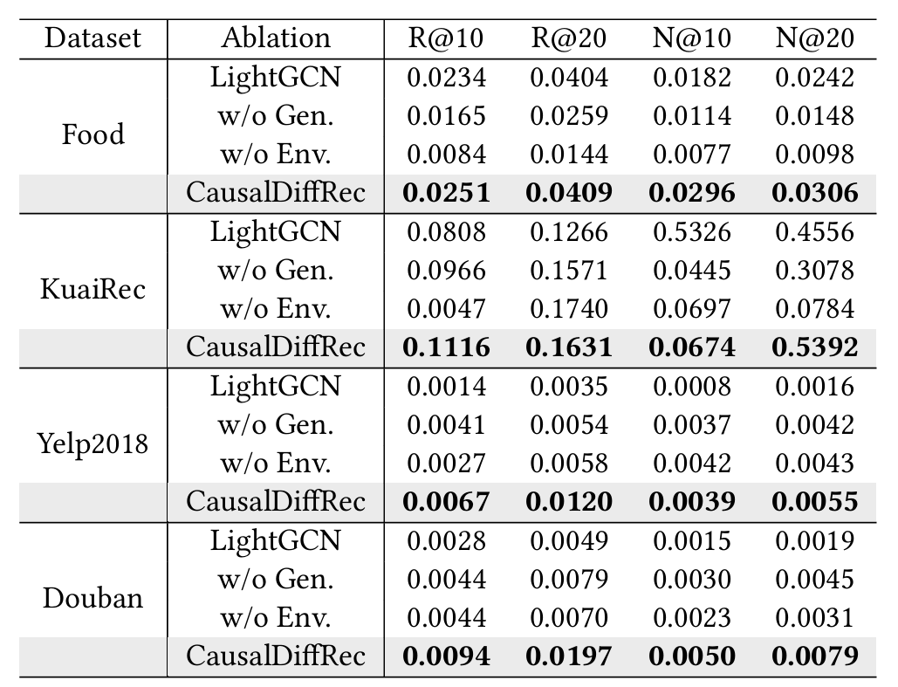
ATAI
Advanced Technique of Artificial Intelligence
ATAI
ChongqingUniversity _{AdvancedTechniqueof}
of Technology Artificial Intelligence
Chongqing University of
Technology
Chongqing University ^{ATAI}
_{of Technology} Advanced Techniqueof
Artificial Intelligence
Chongqing University of Technology
Chongqing University of Technology
Experiments

Slide 11
ATAI
Advanced Technique of Artificial Intelligence
ATAI
ChongqingUniversity _{AdvancedTechniqueof}
of Technology Artificial Intelligence
Chongqing University of
Technology
Chongqing University ^{ATAI}
_{of Technology} Advanced Techniqueof
Artificial Intelligence
Chongqing University of Technology
Chongqing University of Technology
Experiments

Slide 12
ATAI
Advanced Technique of Artificial Intelligence
ATAI
ChongqingUniversity _{AdvancedTechniqueof}
of Technology Artificial Intelligence
Chongqing University of
Technology
Chongqing University ^{ATAI}
_{of Technology} Advanced Techniqueof
Artificial Intelligence
Chongqing University of Technology
Chongqing University of Technology
Experiments

Slide 13
ATAI
Advanced Technique of Artificial Intelligence
ATAI
ChongqingUniversity _{AdvancedTechniqueof}
of Technology Artificial Intelligence
Chongqing University of
Technology
Chongqing University ^{ATAI}
_{of Technology} Advanced Techniqueof
Artificial Intelligence
Chongqing University of Technology
Chongqing University of Technology
Thanks!

